Slide 1
Introduction to embedded systems using arduino
Day 2

Slide 2
Agenda
Embedded System Programming Languages
C Syntax Programming Languages
Getting the Most out of C Language
What is Arduino
Why Arduino
Arduino Boards
Arduino IDE
Arduino code basics

Slide 3
ES Programming Languages
Low-End Development Platforms o Developing simple robotic systems, control systems, IOT, or any sort of “Bare-
Metal” programming with low-end MCUs is done mostly in C. o As well as Assembly for tiny tasks and parts, for loaders, start-up codes and for
context switching. o Occasionally, a very limited version of C++ is also used.
8-Bit MCUs (AVRs, PICs, etc.)
Arduinos
Low-End ARM Microcontrollers (Cortex M0, M3, M4)

Slide 4
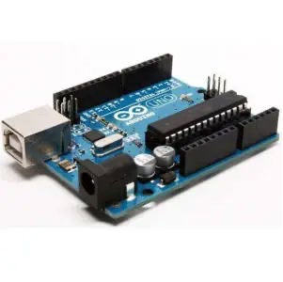
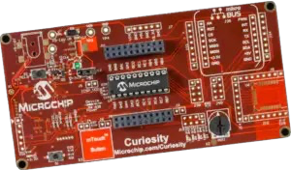
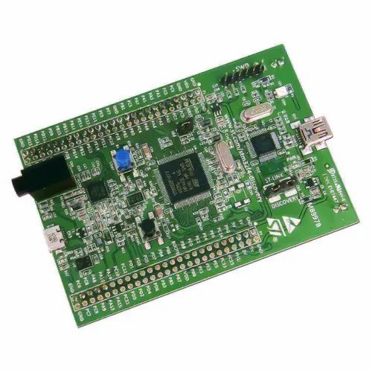
ES Programming Languages
Low-End Development Platforms
o The Arduino programming language ?
o a pseudo-language called wiring and it’s a C++ based and compiles down to machine language using the standard avr-gcc compiler integrated within their IDE.
STM32F407Discovery
Arduino Uno
Microchip PIC Curiosity

Slide 5
ES Programming Languages
High-End Development Platforms
o For developing high-end applications involving complex computations and large data structures manipulations, it’s common to see desktop programming languages like C++, Python, etc.
o This includes the application of Deep Neural Networks(DNN), Computer Vision, and Ai Algorithms. Running on top of an operating system.
o It has been proven that Hardware Acceleration is the way to go for computationally complex Ai stuff.
o Hence, development platforms are getting more and more familiarity in the market. Combining high-end ARM core processors with hardware-reconfigurability of FPGA chips, can tremendously accelerate tons of computational workloads.
o That’s why many embedded engineers do learn a Hardware Description Language (HDL) such as Verilog or VHDL. And it’s getting more traction these days.

Slide 6
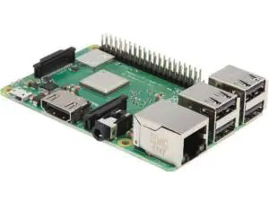
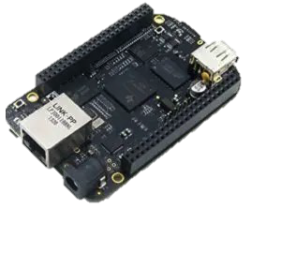
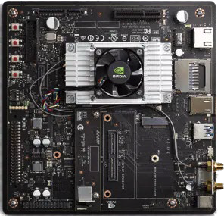
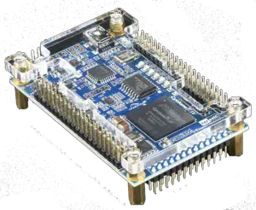
ES Programming Languages
High-End Development Platforms
o Raspberry-Pi o BeagleBone o Nvidia Jetson TX
o FPGA SoC o any platform running Embedded-Linux kind of operating system
Raspberry Pi 3
DE-0 Nano SOC
BeagleBone Black
NVIDIA Jetson TX2

Slide 7
Why C?
One of the most powerful computer programming languages to emerge ever, C is the de-facto choice for embedded systems programming.
C gives access to even the most low-level system components via its built- in pointer.
Developers can create C compilers for their embedded systems pretty quickly, thanks to its widespread popularity.
C combines the low-level functionality of the Assembly language very neatly with modern-day programming conventions.
C’s loose data typing policy makes it ultra suitable for embedded systems programming
Porting embedded programs across different devices is much easier than programs written in other languages (Portable Code)

Slide 8
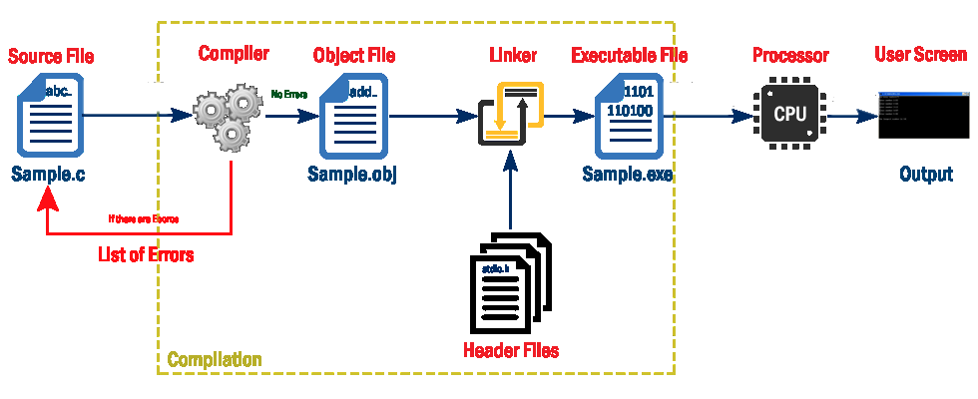
Build Process of a C Program

Slide 9
What is build process
In order to make your code executable, you must provide your code to a language that is suitable to the microprocessor.
Writing a machine language directly is very hard, so we use C language because it's easier for us to understand.
Each processor has its own machine language.
The C build process can be defined as the processes done to convert your code to a machine language that is suitable for the selected targets.
Build process make a level of microprocessor abstraction.

Slide 10
Why learning build process?
Gives you better understanding how your code is converted to machine language.
Gives you better understanding about syntax errors that you are facing and how to fix them quickly.
Gives you better understanding about avoiding warnings that you are facing and how to eliminate them quickly.
Gives you better understanding about how to easily handle multi-file projects.
Gives you better understanding about how variables and functions are shared between files or are private in its files.
Gives you better understanding about how variables and functions are stored in the memory.

Slide 11
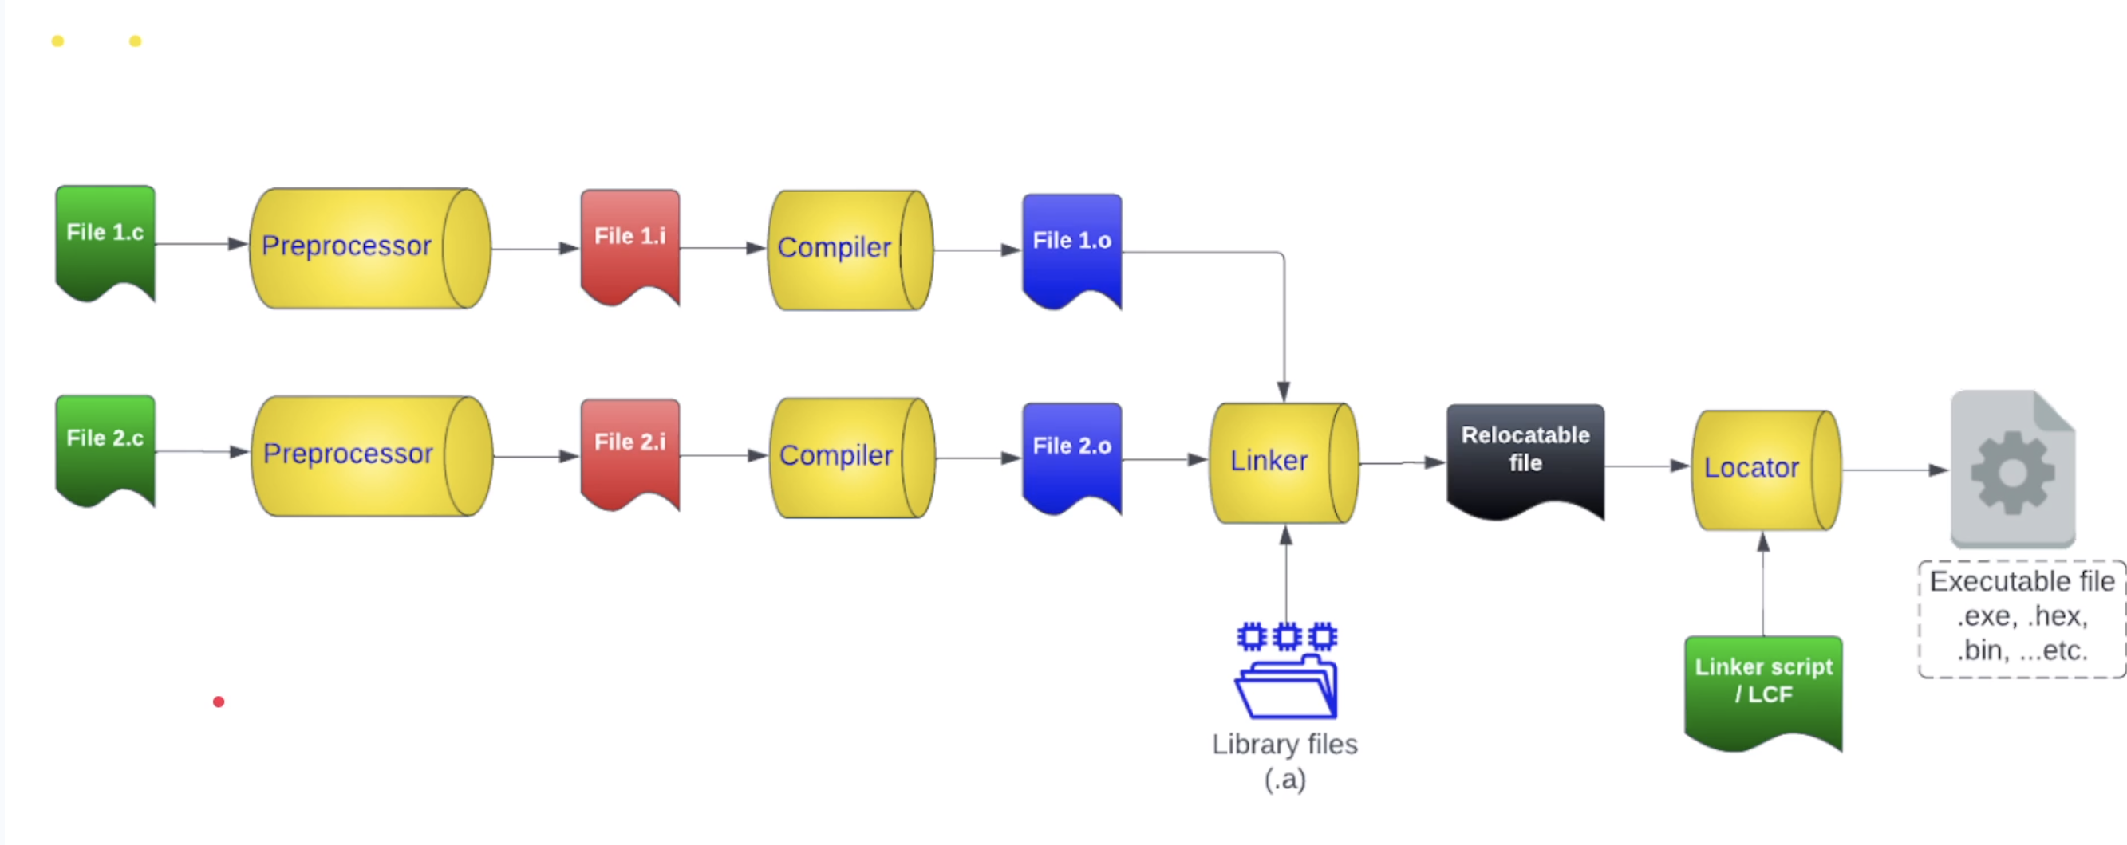
Build Process stages

Slide 12
Preprocessor Directives
The C Preprocessor is not a part of the compiler but is a separate step in the compilation process.
In simple terms, a C Preprocessor (CPP) is just a text substitution tool, and it instructs the compiler to do required pre-processing before the actual compilation.
All preprocessor commands begin with a hash symbol (#)
#define MAX_LEDS 5

Slide 13
Preprocessor Directives
1. Macros directives
#define
2. File directives
#include
3. Conditional Compilation directive
#if
#else
#ifdef
4. Other directives
#error
#undef
#pragma

Slide 14
Preprocessor Directives
# | Directive | Description
1 | #define | Substitutes a preprocessor macro.
2 | #include <file> or “<file>” | Inserts a particular header from another file.
3 | #ifdef | Returns true if this macro is defined.
4 | #ifndef | Returns true if this macro is not defined.
5 | #if | Tests if a compile time condition is true.
6 | #else | The alternative for #if.
7 | #elif | #else and #if in one statement.
8 | #endif | Ends preprocessor conditional.
9 | #undef | Undefines a preprocessor macro.
10 | #error | Prints error message on stderr.
11 | #pragma | Issues special commands to the compiler, using a standardized method.

Slide 15
Preprocessors Examples
#define MAX_ARRAY_LENGTH 20
This directive tells the CPP to replace instances of MAX_ARRAY_LENGTH with 20
Use #define for constants to increase readability.
#include <stdio.h>
#include "myheader.h“
These directives tell the CPP to get stdio.h from System Libraries and add the text to the current source file.
The next line tells CPP to get myheader.h from the local directory and add the content to the current source file.

Slide 16
Preprocessors Examples
#undef FILE_SIZE
#define FILE_SIZE 42
▪ It tells the CPP to undefine existing FILE_SIZE and define it as 42.
#ifndef MESSAGE #define MESSAGE “Embedded Systems Programming!"
#endif
#ifdef DEBUG /* Your debugging statements here */
#endif

